Slide 1
Unit 3: Overloading

Slide 2
Function Overloading
If any class have multiple functions with same names but different parameters then they are said to be overloaded.
Function overloading allows you to use the same name for different functions, to perform, either same or different functions in the same class.
Function overloading is usually used to enhance the readability of the program.
If you have to perform one single operation but with different number or types of arguments, then you can simply overload the function.

Slide 3
Ways to overload a function
By changing number of Arguments.
By having different types of argument.
Advantages of Function overloading:
The programmer need not remember multiple function names.
It makes programming simple.
It promotes virtual polymorphism.

Slide 4


Slide 5
Constructor Overloading
Within a class we can define many constructors.
Defining several constructors by changing the number of arguments, order of arguments, and type of arguments within the same class is called constructor overloading.
This behavior is an polymorphic feature of OOPs.
For Example:

Slide 6
Finding address of an overloaded function
If the function is not overloaded, assign the address of the function to a pointer and then call that function through that pointer.
Consider this statement which assigns the address of myfunc() to a pointer called p.
p= myfunc;
If myfunc() is not overloaded, there is one and only one function called myfunc(), and complier has no difficulty assigning its address to p.
If myfunc() is overloaded, how does the compiler know which version’s address to assign to p?
The answer is, it depends on how p is declared. For ex:

Slide 7
#include<iostream>
using namespace std;
int myfunc(int a);
int myfunc(int a, int b);
int main()
{
int(*fp) (int a); //pointer to int f(int)
fp= myfunc; //points to myfunc(int)
cout<<fp(5);
return 0;
}
int myfunc(int a)
{
return a;
}
int myfunc(int a, int b)
{
return a*b;
}

Slide 8
Here there are two versions of myfunc() both return int, one takes a single integer, the other takes two integer arguments. In the program, fp is declared as a pointer to a function that returns an integer and that takes one integer argument.
When fp is assigned the address of myfunc(), C++ uses this info to select the myfunc(int a) version. Had fp been declared like this :
int (*fp) (int a, int b);
Then fp would have been assigned the address of the myfunc(int a, int b) version of myfunc().
( refer addrof.cpp)

Slide 9
Default Arguments
Few of the arguments having default values at the time of function declaration, these are known as default arguments.
In some situations, a function may contain more parameters than required for its most common usage. i.e., it may not be essential to pass a value for a particular parameter, when the function is called.
To allow the programmer to drop unnecessary parameter(s) during the function call, C++ provides the facility of default arguments.

Slide 10
Default arguments…
Here the programmer needs to specify only those arguments that suit the exact situation.
Consider the program as an illustration.
Note:
1. When a function is declared for the first time, the default values for arguments must be specified. Default values cannot be changed or rewritten.
For ex: in the program, the default value is specified in function prototype as
void fun(int x=20);
During function definition later, default value must not be specified.

Slide 11
But if the programmer wishes to have declaration and definition together, then he/she can provide default argument’s value.
2. All default arguments must appear after ordinary arguments in a parameter_list of function. That is, the following declaration is erroneous.
void fun(int x=20, char y);
Also once the definition of default arguments begins, non-defaulting arguments cannot be specified. i.e., the following declaration is invalid.
void fun(float f, int a, int x=20, char y);
3. Default parameters can be used in constructors also. When a parameterized constructor is defined in a class.

Slide 12
It is necessary to define a non-parameterized default constructor to allow the programmer to create the objects with parameters and without parameters.
Instead of defining such overloaded constructors, a parameterized constructor with default argument can be used.
4. In some situations, default arguments can be used as a shorthand form of function overloading.
As an illustration , consider the following code segment:

Slide 13
void test (int a=30)
{
cout<<“a = “<<a;
}
void test ()
{
cout<<“hello “;
}
Here, there is an overloaded function test(). At a first look, overloading seems to be correct. Because one of the definitions of test() has no arguments; and the other definition has one argument. But usage of these functions in a program generates error due to conflict

Slide 14
When test() is called with no arguments. That is, the function call,
test();
May be for any of the two versions of test() as the argument for first function here is a default argument and it can be called without any argument.
Hence compiler will be in a confusion – whether to call an parameterized test() function by treating default value of a as 30 or to call non-parameterized test() func.
Thus it will throw error.

Slide 15
Function Overloading & Ambiguity
A situation in which the compiler is unable to choose between two overloaded functions.
This situation is said to be ambiguous.
Ambiguous statements are errors, and programs containing ambiguity will not compile.
Main cause of ambiguity involves C++’s automatic type conversions.
C++ automatically attempts to convert the arguments used to call a function into the type of arguments expected by the function.

Slide 16
For example, consider this fragment:
int myfunc(double d);
cout<<myfunc(‘c’ ); // not an error, conversion applied.
As the comment indicates, this is not an error because C++ automatically converts the char c into its double equivalent.
In C++ very few type conversions of this sort are actually disallowed.
Although automatic type conversions are convenient, they are also prime cause of ambiguity.
For example consider the following program (refer ambiguity.cpp program)

Slide 17
Another way you can cause ambiguity is by using default arguments in overloaded functions. (refer ambiguity1.cpp program)
Here in the first call to myfunc(), two arguments (4,5) are specified; therefore, no ambiuity is introduced and myfunc(int i, int j) is called.
When second call to myfunc() is made, ambiguity occurs because the compiler does not know whether to call the version of myfunc() that takes one argument or to apply the default to the version that takes two arguments.

Slide 18


Slide 19
Introduction:
Operator overloading is an important concept in C++.
It is a type of polymorphism in which an operator is overloaded to give user defined meaning to it.
that is, Overloaded operator is used to perform operation on user-defined data type.
To be more clear:
All operators are designed to perform particular operation only on predefined data type ( i.e., either int or float etc)
Now , consider there are two objects.. Obj1 and obj2

Slide 20
Class is a user defined data type . If we add Obj1 + Obj2 then it gives error. Because operator works on predefined data type and not on user defined.
To overcome this issue, C++ provides a concept called operator overloading.
Definition: An operator overloading which allows to define a function using an operator instead of a function to do a specific task.

Slide 21
We would overload the operators by creating operator functions. An operator function defines the operations that the overloaded operator will perform relative to the class on which it works. This function is created using the keyword operator.
  The operator functions may be member of the class or they can be friend functions of the class. Possibility of an operator function and its possible arguments are better understood in following figure.

Slide 22
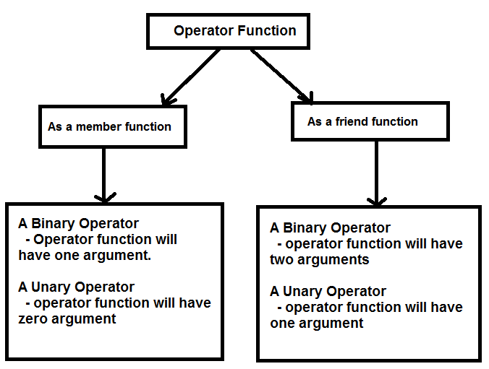

Slide 23
Operator Overloading
Almost any operator can be overloaded in C++.
However there are few operator which cannot be overloaded. Operator that are not overloaded are follows
  scope operator - ::
  sizeof
  member selector - .
  member pointer selector - *
  ternary operator - ?:

Slide 24
Restrictions on Operator Overloading
Following are some restrictions to be kept in mind while implementing operator overloading.
  Precedence of an operator cannot be changed.
  Numbers of Operands that an operator takes cannot be changed. i.e., Unary operator remains unary, binary remains binary etc.
  No new operators can be created, only existing operators can be overloaded.
  Cannot redefine the meaning of a procedure. You cannot change how integers are added.

Slide 25
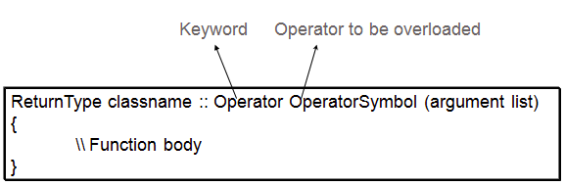
Operator Overloading Syntax

Slide 26
Implementing Operator Overloading
Operator overloading can be done by implementing a function which can be :
  Member Function /Non-Member Function
  Friend Function

Slide 27
Operator overloading using Friend function
An operator overloading function for a class may be a member function or a friend function for a class.
Since friend function is not a member function, it will not have this pointer associated with it.
Therefore for overloading a binary operator we need to specify two parameters for the function corresponding to two operands.
And for unary operator, we much have one parameter and the right operand is passed to the second parameter.
For Ex. (refer: oprfrnd1.cpp)

Slide 28
Some restrictions while overloading an operator as a friend function are:
We may not overload =, (), [], -> operators
When overloading increment(++) and decrement(--) operators, we need to use reference parameter .
Consider for example to overload unary operator (++ and --) using a friend function
  (refer: oprfrnd2.cpp)

Slide 29
Dynamic Memory Allocation in C++
In static memory allocation we are specifying the size at the design time.
That is, specifying the variable or array size , the memory is decided by compiler and operating system will allocate memory.
But this cause the wastage of memory if not used.
For ex: consider,
int a[5] = {10, 20};
When program is compiled, here array size is 5 so 10 bytes of memory is allocated. But we have taken only two integers so only 4 bytes are used and remaining 6 bytes of memory got wasted.

Slide 30
To avoid this wastage of memory, Dynamic Memory has been used.
Here user will allocate the memory at runtime ( not the Operating system).
To perform dynamic memory allocation in C we use malloc, calloc,and realloc
in C++, we use an operator called new
In C, all these functions malloc, calloc, realloc , their return type is void*. So we require explicit typecasting . But using new operator implicit typecasting takes place.
For new operator no need of any header files as for malloc we use <alloc.h>

Slide 31
Common thing both in C and C++, in all dynamic memory allocation, the memory is allocated in Heap area.
Heap is permanent until the block is closed or delete operator is used to release memory.
This concept is called Dynamic Memory De-allocation.
Consider for example, how dynamic memory allocation done using new and delete operators.

Slide 32
‘new’ operator and ‘delete’ operator
new and delete operators are provided by C++ for runtime memory management. They are used for dynamic allocation and freeing of memory while a program is running.
The new operator allocates memory and returns a pointer to the start of it.
  new allocates memory on the heap. If there is insufficient memory, then new will fail and a bad_alloc exception will be generated.
The delete operator frees memory previously allocated using new.
The general form of using them is :
  p_var = new type;
  delete p_var;

Slide 33
Why overload new and delete?
To take charge or control over how to allocate memory
To aid in debugging; keep track of memory allocation and deallocation in the program
To do some other operation apart from allocating memory at the time of memory allocation /
de-allocation.

Slide 34
To overload new and delete operator :
void* operator new(size_t num)
{
return malloc(num);
}
void operator delete(void *ptr)
{
free(ptr);
}

Slide 35
End of Unit 3

